Slide 1
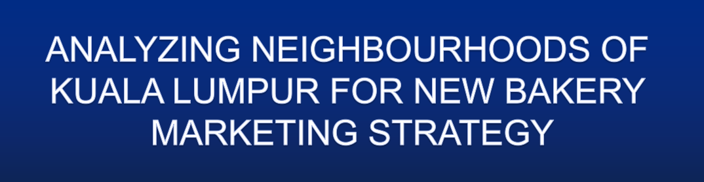
IBM APPLIED DATA SCIENCE CAPSTONE PROJECT
BY
N.VIGNESWARAN
DECEMBER 2020

Slide 2
Kuala Lumpur, or KL, is the federal capital and most populous city of Malaysia.
An approximation population of 7.2 million in 2016 and now in 2020 estimated at 7,996,830.
Comprises of multi-ethnic cultures.
Malaysian market has seen positive growth of baked goods

Slide 3
To find strategic location for opening new bakery
To extract and analyse a various data about neighbourhood of Kuala Lumpur

Slide 4
To solve the problem, we will need the following data:
  [A] List of Kuala Lumpur neighbourhood
  [B] Geographical coordinates of neighbourhood
  [C] Venue data from Foursquare

Slide 5
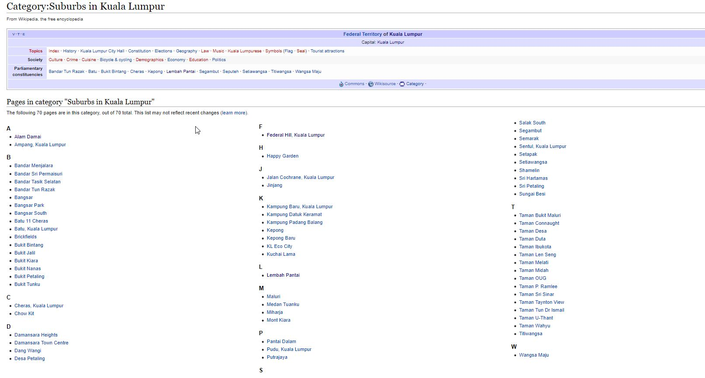
[A] List of Kuala Lumpur neighbourhood
Web scrapping with BeautifulSoup library in Python

Slide 6
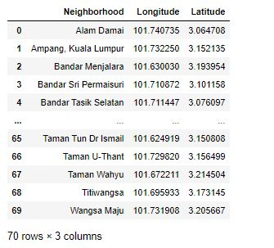
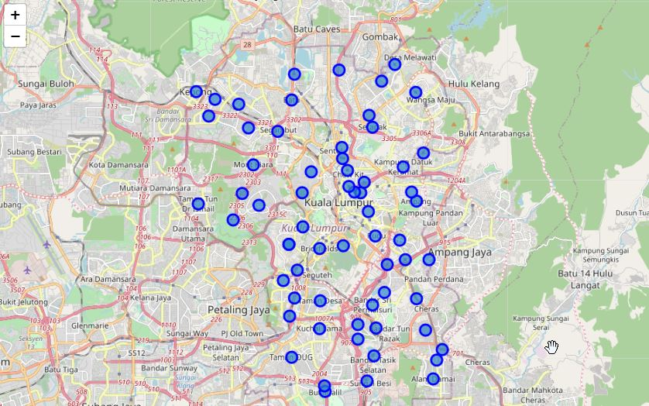
[B] Geographical coordinates of neighbourhood
Geographical coordinates of various suburbs in Kuala Lumpur were extracted using Geopy geocoders

Slide 7
[C] Venue data from Foursquare
Various locations of existing bakeries around the neighbourhood data extracted using Foursquare API
The collected data is used to analyse and draw conclusion of this project.

Slide 8
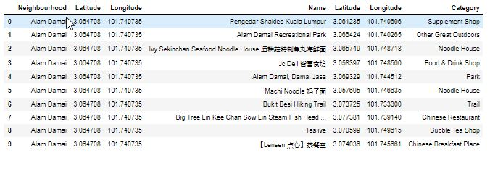
1) The data for venues retrieved from Foursquare within 2000 meter

Slide 9
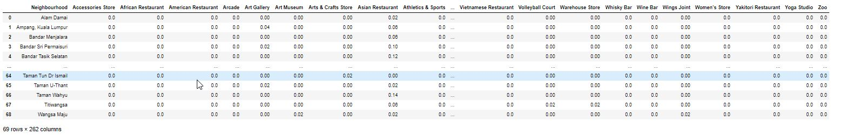
2) The data frame was transformed with the venues,by one-hot encoding (0/1)
3) Group rows by neighbourhood

Slide 10
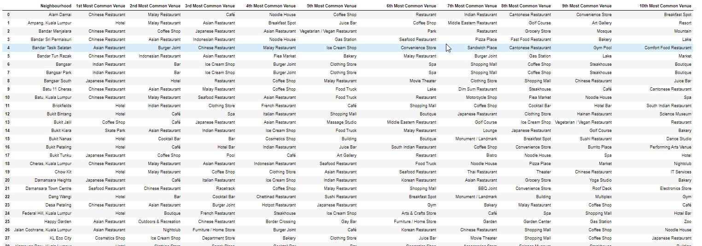
4) Create a top 10 most common venue types for each neighbourhood

Slide 11
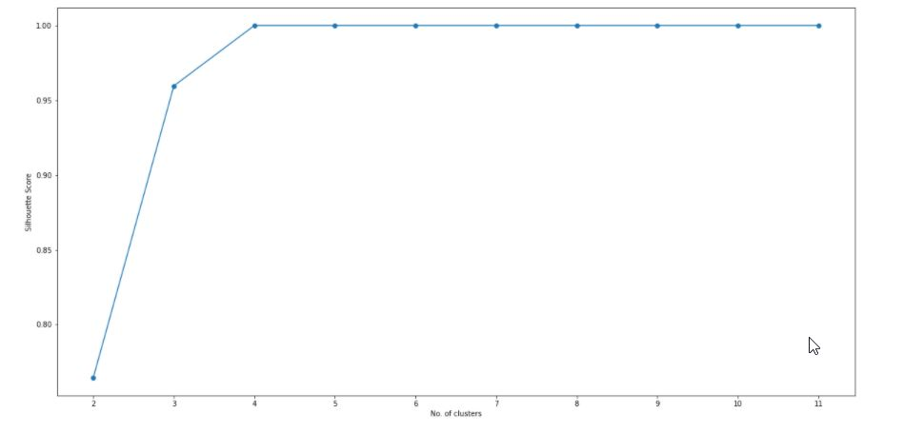
5) K means clustering algorithm was implemented and elbow method was
use to identify optimal value of clusters
The plot show that the optimal number of clusters is 4

Slide 12
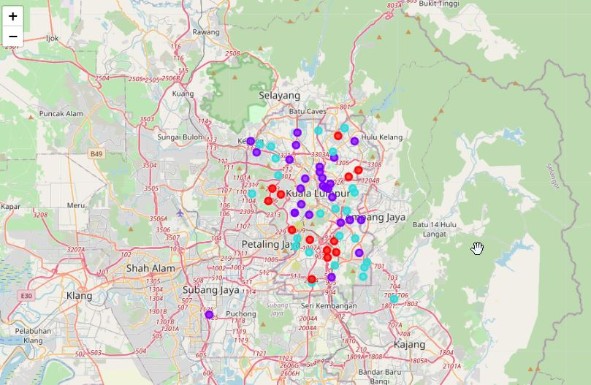
The neighbourhood marked with a cluster-specific color on a map
After examining the all 4 individual clusters, some important conclusion was derived
The neighbourhood that have most number of bakeries is Cluster 1

Slide 13
The most suitable neighbourhood to start a bakery is present in Cluster 1
Less competition areas:
  Bandar Sri Permaisuri, Taman Desa, Sri Hartamas, Desa Petaling, Damansara Heights and Bukit Kiara.
Low cost area:
  Desa Petaling
  Suitable location to start ‘Cloud Bakery’ or bakery without dining area

Slide 14
Data science and machine learning techniques used in this project were very helpful to derived the results.
We achieved the goal presented and the entrepreneurs or business peoples can see in the results which neighbourhood best match for their bakeries.

Slide 15


